Slide 1
Sales Products 2012- 2014
By – Rabindra Goswami

Slide 2
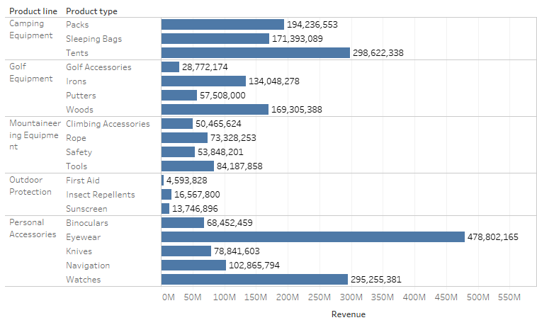
Different Product under Product line and Revenue

Slide 3
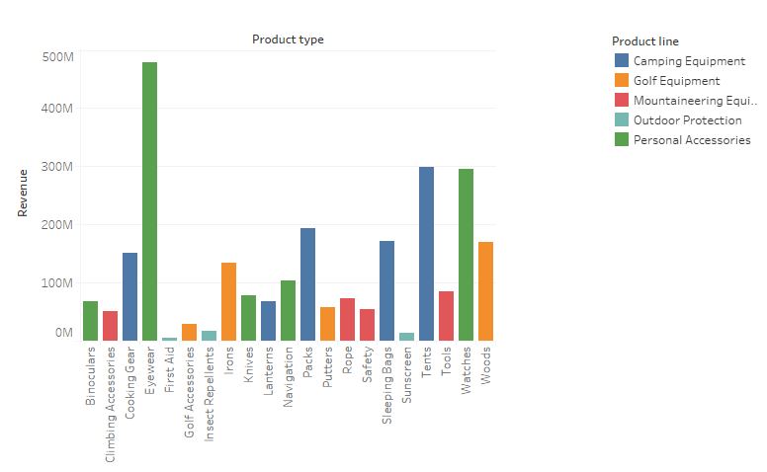
Revenue for Different Product type across product line

Slide 4
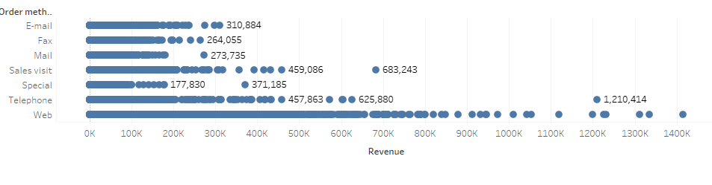
Revenue at different Order Method

Slide 5
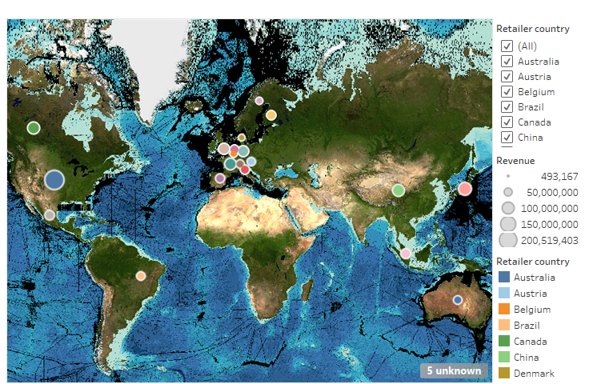
Product Distribution Country Wise

Slide 6
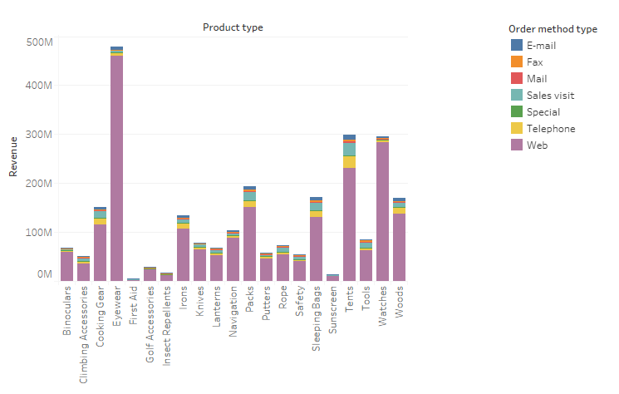
Revenue VS Product Type for different order method type

Slide 7
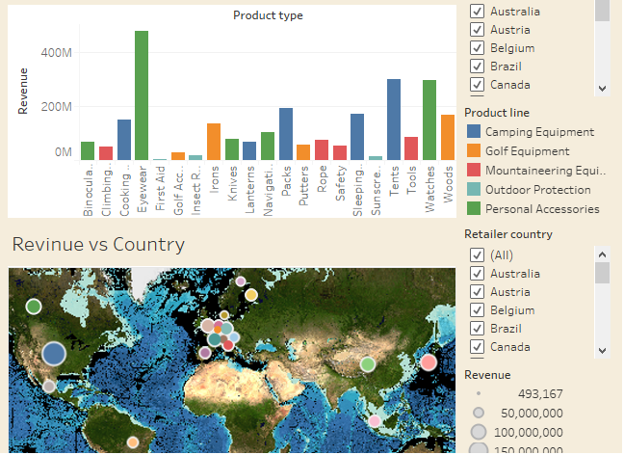
Product Type

Slide 8
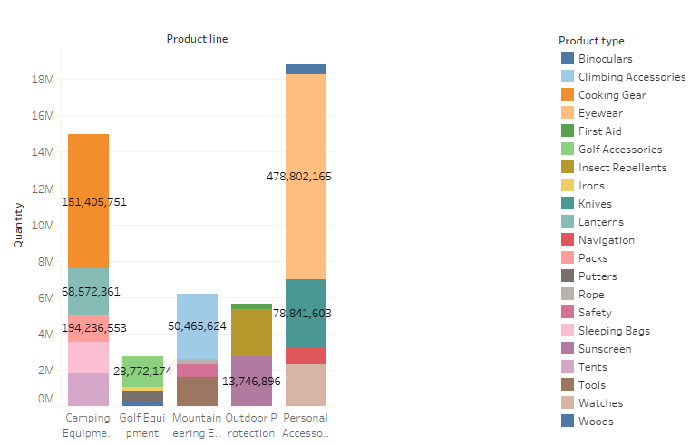
Quantity Product Line

